Slide 1
3D Transformation

Slide 2
Transformations

Slide 3
3D Axis

Slide 4
3D Transformation

Slide 5
3D Translation

Slide 6
3D Scaling

Slide 7
3D Rotation

Slide 8
3D Rotation

Slide 9
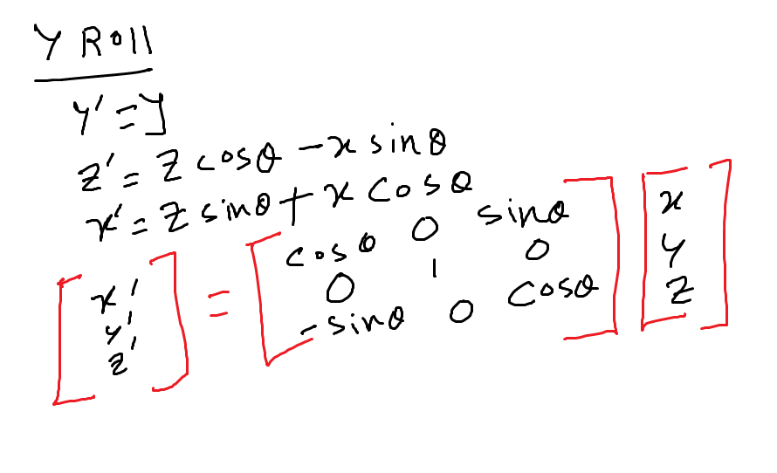

Slide 11
Reflection
XY Plane:
YZ Plane

